Slide 1
Predictive Maintenance Analysis for Water Pump Sensor
By Ditsa Pandey
PGA 22

Slide 2
Contents for Predictive Maintenance
Introduction
Problem Statement
Objective
Related Work
Implementation
Summary
Conclusion

Slide 3
Introduction
What is predictive maintenance?
In predictive maintenance scenarios, data is collected over time to monitor the state of equipment. The goal is to find patterns that can help predict and ultimately prevent failures.
This is a powerful technique that helps businesses reduce downtime, minimize repair costs and increase overall efficiency.
The benefits of predictive maintenance is to help determine the condition of equipment and predicting when maintenance should be performed, are extremely strategic.

Slide 4
Problem Statement
This data is of water pump in small area where supply is provided to a big town located far from it.
The water pump sensor dataset for a company handling water pump for supply in a town everyday. This dataset consists of 220320 rows and 54 columns consisting of unique id, timestamp, details about the sensors.
Data Definitions :
Unnamed 0: Consists of Id foe each time of sensors working.
timestamp : Date and time(year, month, day, hour, minute) for each sensors
sensor_00 to sensor_51 : This is total of 52 sensors and performance value of each sensors for every hour.

Slide 5
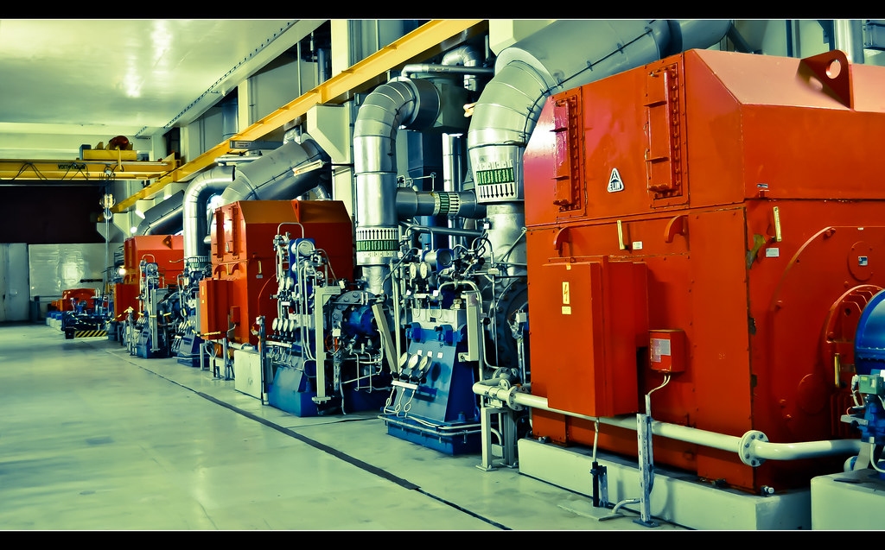
Objective
This Photo by Unknown Author is licensed under CC BY-SA-NC
Prediction of failure of equipment .
reinforcing better preventive maintenance schedule.
Lesser downtime of equipment.

Slide 6
Related Work
Import libraries and Load data
Preprocessing of the data
Visualization and Exploratory Data Analysis
Time –series analysis and feature-selection
Model training, Evaluation and Hyperparameter Tuning

Slide 7
Implementation
Preprocessing and EDA
Checking for missing values
Finding correlations between dataset
Visualization of the dataset.
Time series analysis and conversion to supervised machine learning
Analysis of machine status.
Converting the dataset from Time-Series using lagged features.
Finding best features using Dimensionality reduction feature selection.

Slide 8
Implementation
Machine learning model fitting and evaluation
Spliting dataset into training and testing
Training using different model
Evaluation of model performance
Hyperparameter tuning of ML model.

Slide 9
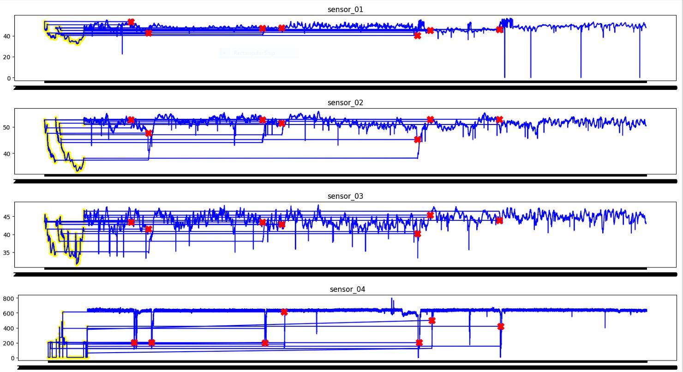
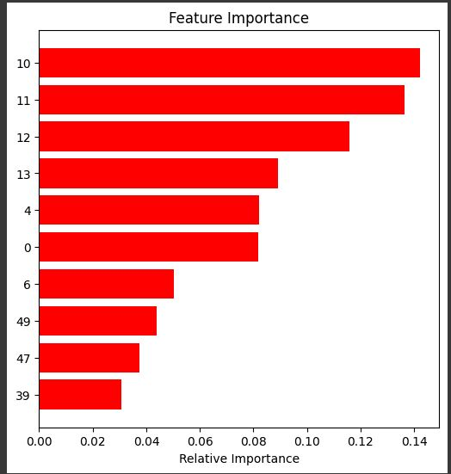
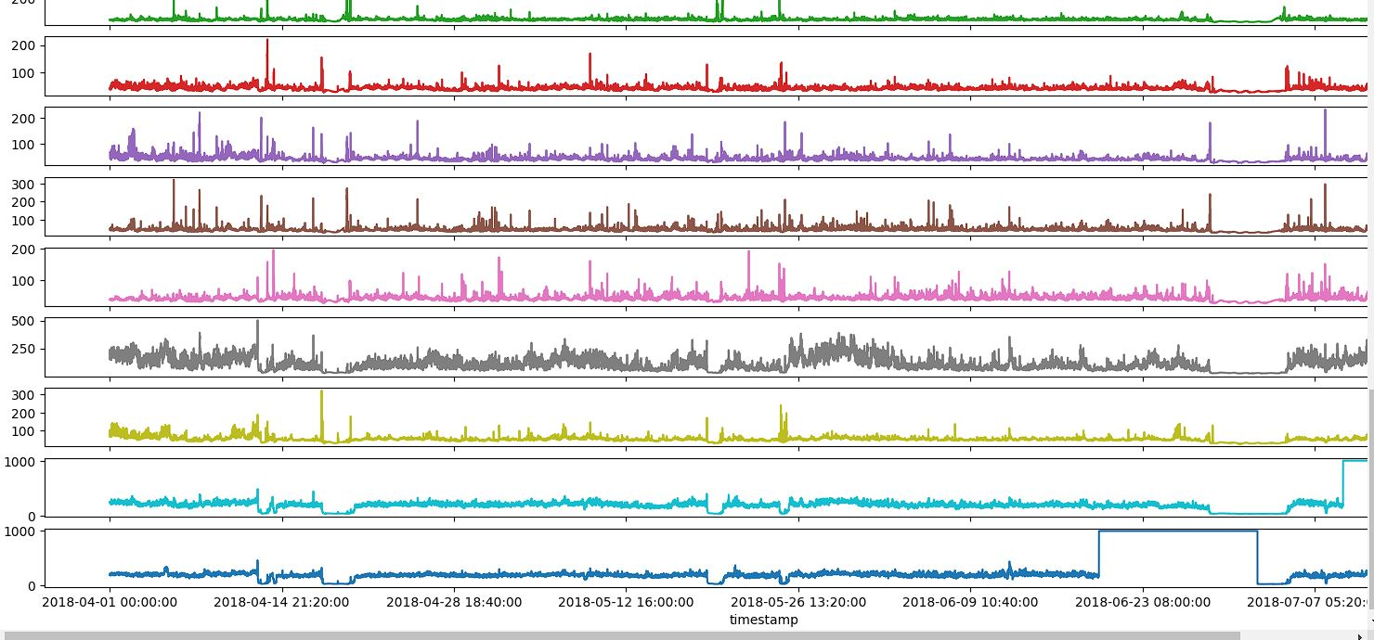
This is working image of different sensors for predictive maintenance which gives information about how machines is working.
The blue represents the normal working of the sensors
The yellow part informs about the recovery of the status of the machine
The red describes the downtime of the machine .
Best performing sensors

Slide 10
Summary
We have performed a to predict downtime or normal operation using different classifier algorithms.
As the dataset is unbalanced with a majority of normal operation target data, weights for this class are given lower influence.
With this method we can predict the major downtime periods based on the most important sensors.
There seems to be no cyclic relationship between downtime and time of day or day of the week. This makes forecasting the sensor signals quite hard to get right.

Slide 11
Conclusion
Data is highly unbalanced, which means model will be highly biased towards ‘Normal’ machine status.
Further we can use the Time Series to understand the machine behaviour and schedule advance maintenance to reduce overall cost.

Slide 12
References
Zhao, K. (2019, December 10). Feature extraction using principal component analysis - A simplified visual demo. Medium. Retrieved July 19, 2022, from https://towardsdatascience.com/feature-extraction-using-principal-component-analysis-a-simplified-visual-demo-e5592ced100a
Predictive maintenance: Unsupervised and supervised machine learning. YouTube. Retrieved July 19, 2022, from https://www.youtube.com/watch?v=AS0H43hMoWM&amp;t=1430s
Jananikariyawasam. (2021, October 14). Data Cleaning and feature engineering. Kaggle. Retrieved July 19, 2022, from https://www.kaggle.com/code/jananikariyawasam/data-cleaning-and-feature-engineering
A Brief Introduction to SciKit Pipelines, from https://towardsdatascience.com/a-brief-introduction-to-scikit-pipelines-888edc86da9b
Predicting supply downtime using Lagged Features and Classifiers,Author: Christian Grech from https://www.kaggle.com/code/antimattermatters/using-xgboost-to-predict-supply-downtime
https://towardsdatascience.com/how-to-implement-machine-learning-for-predictive-maintenance-4633cdbe4860
Time Series Analysis with Python Cookbook: Practical recipes for exploratory data analysis, data preparation, forecasting, and model evaluation by Tarek A. Atwan (Author)

Slide 13
Thank you!

